Slide 1
Handwritten digit recognition
Faculty: Prof. Sankar Ganesh S
Slots: E1, E2
Aman Sardana (13BEC0107)
Rakshith Manandi (13BEC0390)
Vinay Gupta (13BEC0749)
ECE407: Neural Networks and Fuzzy Control

Slide 2
Application considered
We used the publicly available MNIST (Mixed National Institute of Standards and Technology) database of handwritten digits.
80% of records were taken for training, and rest for testing.
The MNIST database contains images of size 28 x 28 pixels each. They are 8-bit grayscale images with intensities ranging from 0-255.
The network structure and algorithm is explained next.

Slide 3


Cost function and weight update rule
The weight updates are calculated from the partial derivatives as follows:
Where alpha is the learning rate, t is the target, y is the output. g is the sigmoid activation function. The weights are optimized using the conjugate gradient function, using back propagation algorithm.
We also used regularization with a parameter lambda to control overfitting.

Slide 4
Network Design
Number of output nodes = 10
Number of input nodes = 28*28 = 784
Number of hidden layers = 1
Number of hidden nodes = 100
In addition, each layer except output layer has a bias unit with input value fixed at 1.
784 nodes
100 nodes
10 nodes
100 x 785
101 x 10

Slide 5
Results from Review 1 (19/10/2016)
Our implementation achieved (using 20 hidden nodes only):
~82% for training accuracy
~79% for testing accuracy
We also planned to investigate network performance with real pictures of digits, with image pre-processing as required. Further, we also try to improve performance as per general guidelines by adjusting number of hidden nodes.

Slide 6
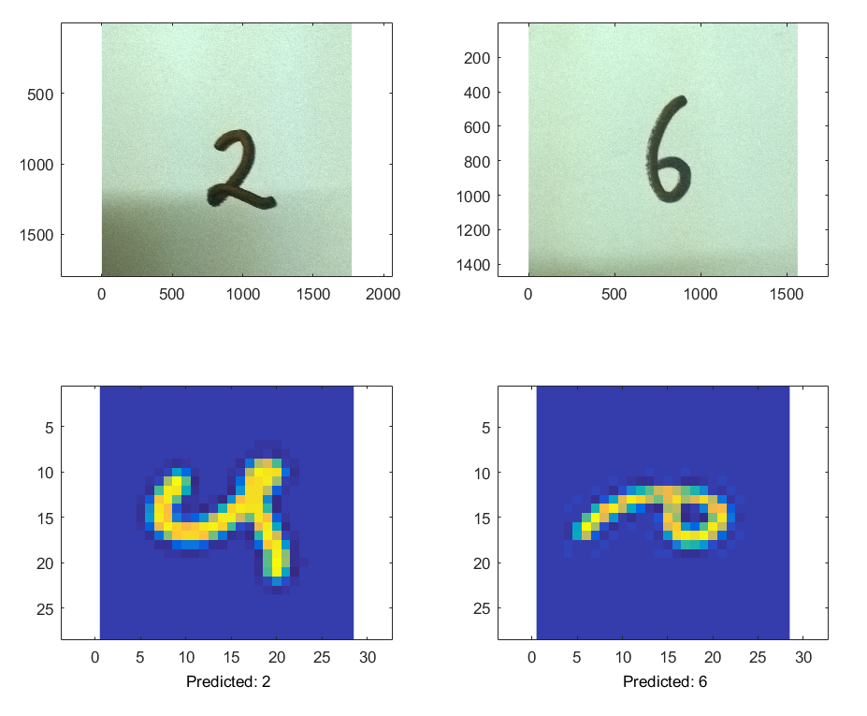
Results and real-life experimentation
The current implementation based on MNIST database achieves
~95% for training accuracy
~93% for testing accuracy
Which is appreciably good for a simple back-propagation network used.
We also investigate network performance with real pictures of digits, with pre-processing as required. Basically, the color images taken from a regular camera are converted to gray-scale and smoothened, and finally thresholded appropriately to feed into the network.

